Slide 1



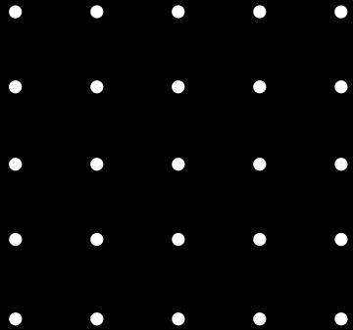
MACHINE LEARNING
RUPAM SHIL
ENG19CS0265

Slide 2
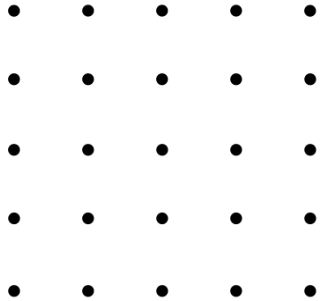

Introduction
Supervised, unsupervised and Reinforcement Learning
Data warehouse
Data mining
Linear Regression
Logistic Regression
Decission Tree
KNN
SVM
Agenda

Slide 3


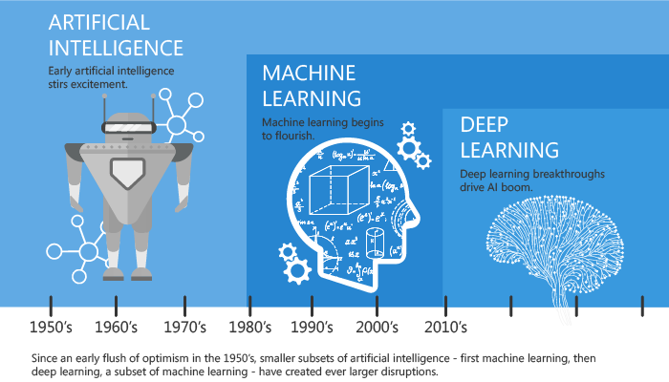
Introduction
MACHINE LEARNING ALGORITHMS ENABLE THE COMPUTERS TO LEARN FROM DATA, AND EVEN IMPROVE THEMSELVES, WITHOUT BEING EXPLICITLY PROGRAMMED. IT IS A SUBSET OF ARTIFICIAL INTELLIGENCE

Slide 4
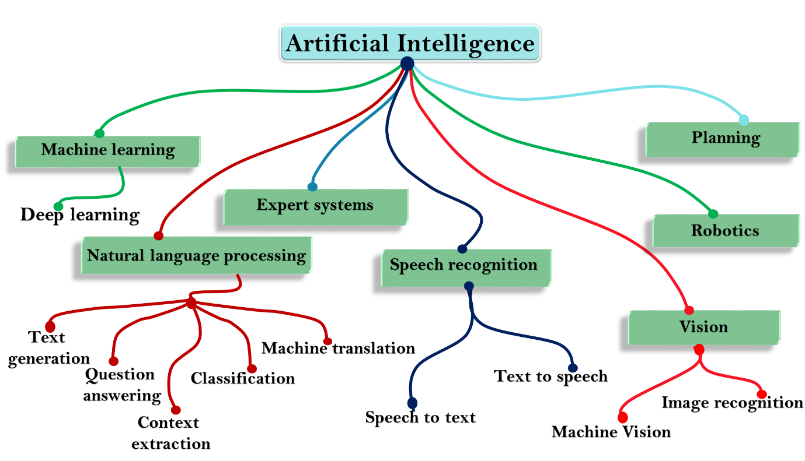
Introduction
Machine learning is a part of AI which provides intelligence to machines with the ability to automatically learn with experiences without being explicitly programmed.

Slide 5
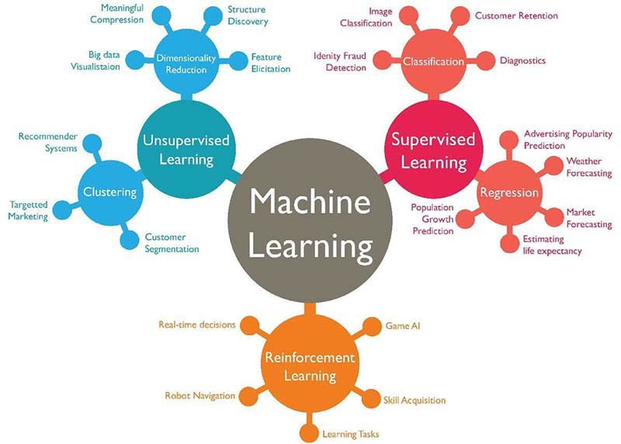
Types of
ML
Supervised Learning
Unsupervised Learning
Reinforcement Learning

Slide 6
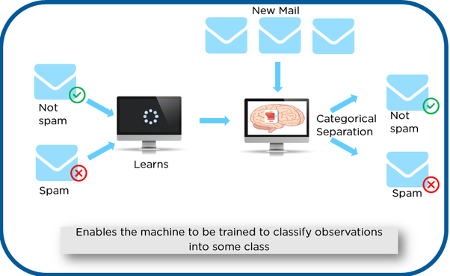
Supervised Learning
Supervised learning, as the name indicates, has the presence of a supervisor as a teacher. Basically supervised learning is when we teach or train the machine using data that is well labeled. Which means some data is already tagged with the correct answer. After that, the machine is provided with a new set of examples(data) so that the supervised learning algorithm analyses the training data(set of training examples) and produces a correct outcome from labeled data.

Slide 7
Types of
Supervised Learning
Classification: A classification problem is when the output variable is a category, such as “red” or “blue” or “disease” and “no disease”.
Regression: Regression models (both linear and non-linear) are used for predicting a real value, like salary for example.

Slide 8
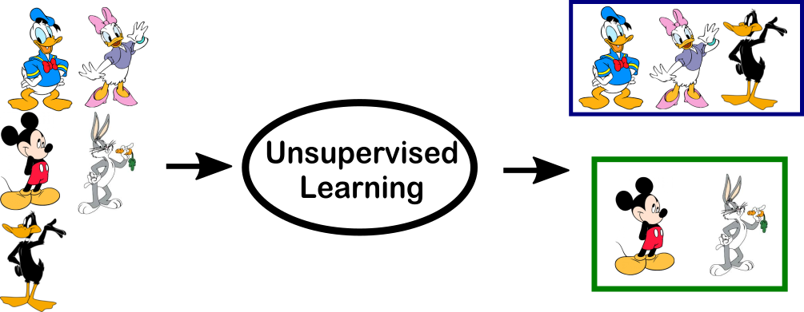
Unsupervised Learning
Unsupervised learning is the training of a machine using information that is neither classified nor labeled and allowing the algorithm to act on that information without guidance. Here the task of the machine is to group unsorted information according to similarities, patterns, and differences without any prior training of data.

Slide 9
Clustering: A clustering problem is where you want to discover the inherent groupings in the data, such as grouping customers by purchasing behavior.
Association: An association rule learning problem is where you want to discover rules that describe large portions of your data, such as people that buy X also tend to buy Y.
Types of
Unupervised Learning

Slide 10

Reinforcement Learning
A reinforcement learning algorithm, or agent, learns by interacting with its environment. The agent receives rewards by performing correctly and penalties for performing incorrectly. The agent learns without intervention from a human by maximizing its reward and minimizing its penalty.

Slide 11
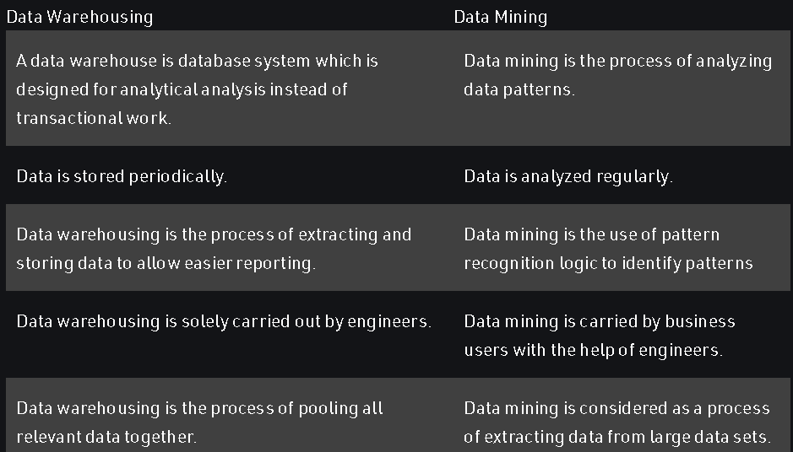
Data Warehousevs
Data
Mining

Slide 12
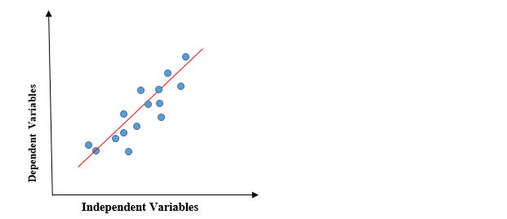
Linear Regreesion
Linear regression is a quiet and simple statistical regression method used for predictive analysis and shows the relationship between the continuous variables. Linear regression shows the linear relationship between the independent variable (X-axis) and the dependent variable (Y-axis), consequently called linear regression. If there is a single input variable (x), such linear regression is called simple linear regression. And if there is more than one input variable, such linear regression is called multiple linear regression. The linear regression model gives a sloped straight line describing the relationship within the variables.

Slide 13
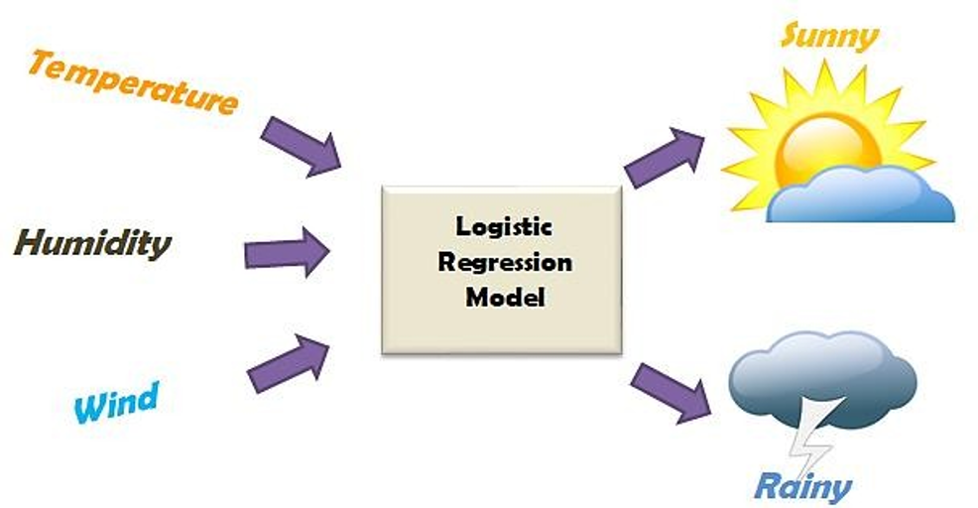
Logistic Regreesion
It’s a classification algorithm, that is used where the response variable is categorical. The idea of Logistic Regression is to find a relationship between features and probability of particular outcome.
E.g. When we have to predict if a student passes or fails in an exam when the number of hours spent studying is given as a feature, the response variable has two values, pass and fail.

Slide 14
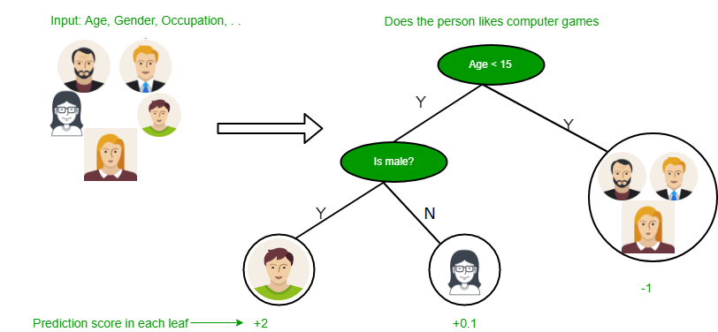
Decision
Tree
Decision tree as the name suggests it is a flow like a tree structure that works on the principle of conditions. It has mainly attributes that include internal nodes, branches and a terminal node.Every internal node holds a “test” on an attribute, branches hold the conclusion of the test and every leaf node means the class label.

Slide 15
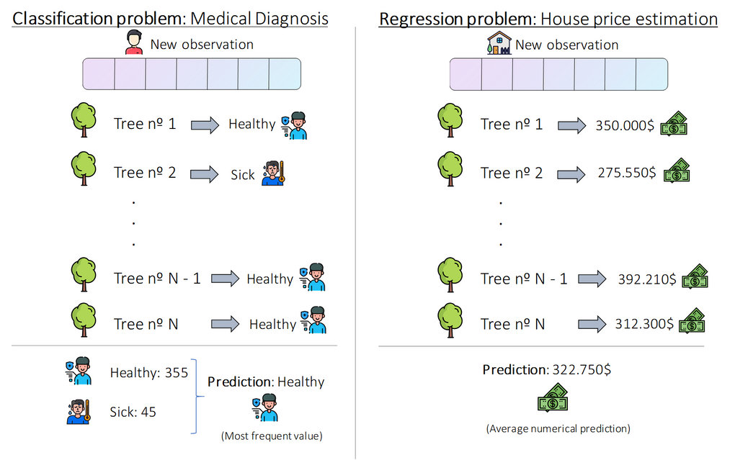
Random Forest
Random forest, like its name implies, consists of a large number of individual decision trees that operate as an ensemble. Each individual tree in the random forest spits out a class prediction and the class with the most votes becomes our model’s prediction

Slide 16
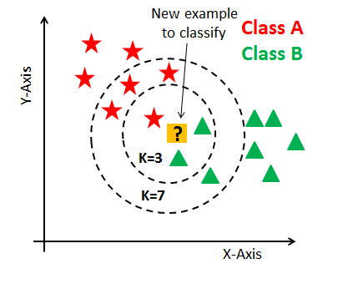
KNN
To make a prediction, the KNN algorithm will use the entire dataset. Indeed, for an observation that isn’t part of the dataset and is the actual value we want to predict, the algorithm will look for the K instances of the dataset closest to our observation.
Then for these K neighbors, the algorithm will use their output in order to calculate the variable y of the observation that we want to predict.

Slide 17

SVM
The goal of the SVM algorithm is to create the best line or decision boundary that can segregate n-dimensional space into classes so that we can easily put the new data point in the correct category in the future. This best decision boundary is called a hyperplane.
SVM chooses the extreme points/vectors that help in creating the hyperplane. These extreme cases are called as support vectors, and hence algorithm is termed as Support Vector Machine

Slide 18

Thank you!
ENG19CS0265
RUPAM SHIL

